Slide 1

AtliQ Grand Data Analysis
Using Power BI
By Aditya Raj

Slide 2




Overview of AtliQ Grands
AtliQ Grands, a well-established hotel chain operated across Bengaluru, Hyderabad, Delhi, Mumbai in India.
They are Facing challenges in market share and revenue because of their Competitors making strategic moves and losing customers to other hotels.

Slide 3
Types of AtliQ Hotels
Seasons
Exotica
Bay
Palace
Types of Rooms
Standard
Elite
Presidential
Premium

Slide 4

Data Analysis Step
Understand Business Problem
Data Collection and Understanding
Power Query
(Data Transformation)
DAX
(Making new Columns, and Measures)
Dashboarding
and
Insight Generation

Slide 5
Problem Statement
Challenge: Revenue and Market Share Drop
Problem: AtliQ Grands is facing a significant drop in revenue and market share.
Impact: This is causing financial strain and demands urgent attention.
Objective: Figure Out Why and Improve
Goal: Understand why this is happening and come up with a plan to make things better.
Approach: Use data to get deep insights into what's causing the decline and how to turn things around.
Challenge: Tough Competition in Hospitality
Situation: The hotel business is super competitive right now.
Response: AtliQ Grands needs to respond smartly to not just survive but thrive in this competitive environment.

Slide 6




Data Collection and Understanding
Data Sources:
dim_date.csv
dim_hotels_csv
dim_rooms.csv
fact_aggregated_bookings
fact_bookings.csv
Available data duration
Note: Total number of records are more than 1 Lakh 30 thousand and currency in INR

Slide 7
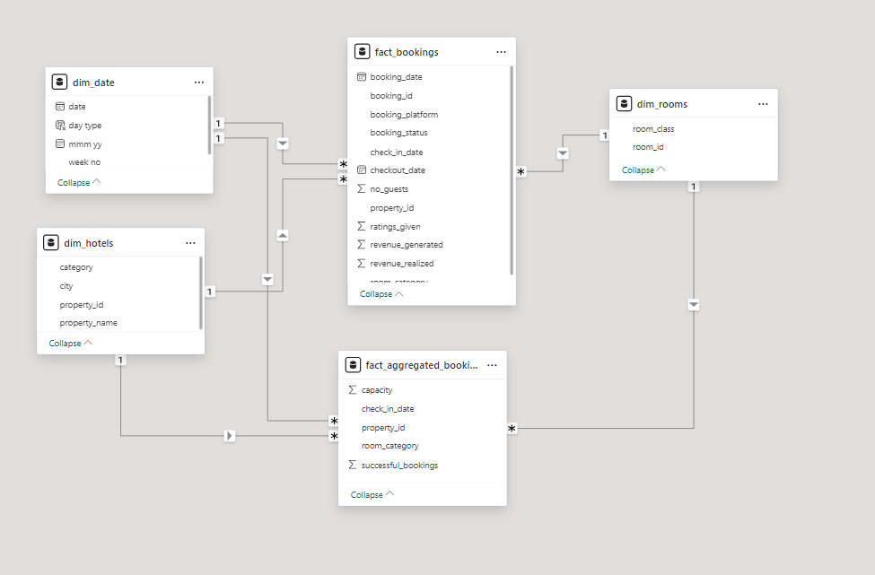
Data Modeling
Structure Overview:
The data model consists of 3 dimension tables and 2 fact tables arranged in a star schema type model.
Key Relationships:
Dimension tables are connected to fact tables using one-to-many relationships.
Measures:
Created 20+ DAX measures used in the analysis for building visuals.

Slide 8
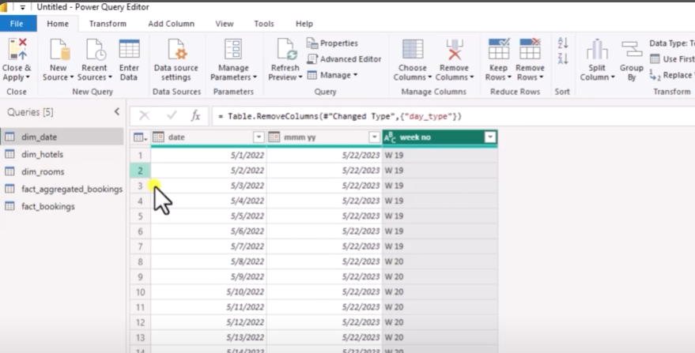

Power Query (Data Cleaning and Transformation)
Invalid guest records with negative values were removed using Power BI’s data transformation capabilities in Power Query, ensuring data accuracy and eliminating potential errors.
Removed outliers in revenue generated for accurate and reliable analysis by leveraging Power BI's statistical functions such as mean and standard deviation in Power Query, proceeding with cleaned data for further analysis.

Slide 9
Key Matrix
ADR - Average daily rate: average payment for rooms sold in a given time period
RevPAR- Revenue Per Available Room: RevPAR represents the revenue generated per available room, whether or not they are occupied
Realization % = Percentage of successfully checked out bookings over all bookings made.
Occupancy % = Percentage of total successful bookings happened to the total rooms capacity
DBRN-Daily booked room nights: average no. of rooms booked per day during a time period.
DSRN- Daily sellable room nights: average no. of rooms available for sale per day during a time period.
DURN- Daily utilized room nights: average no. of rooms successfully used by customers per day during a time period

Slide 10
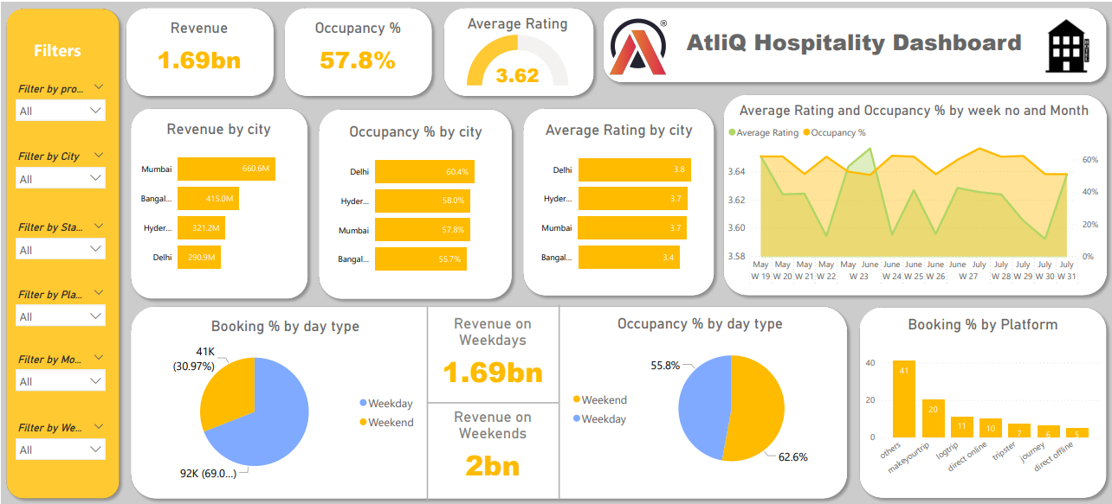
Dashboarding

Slide 11
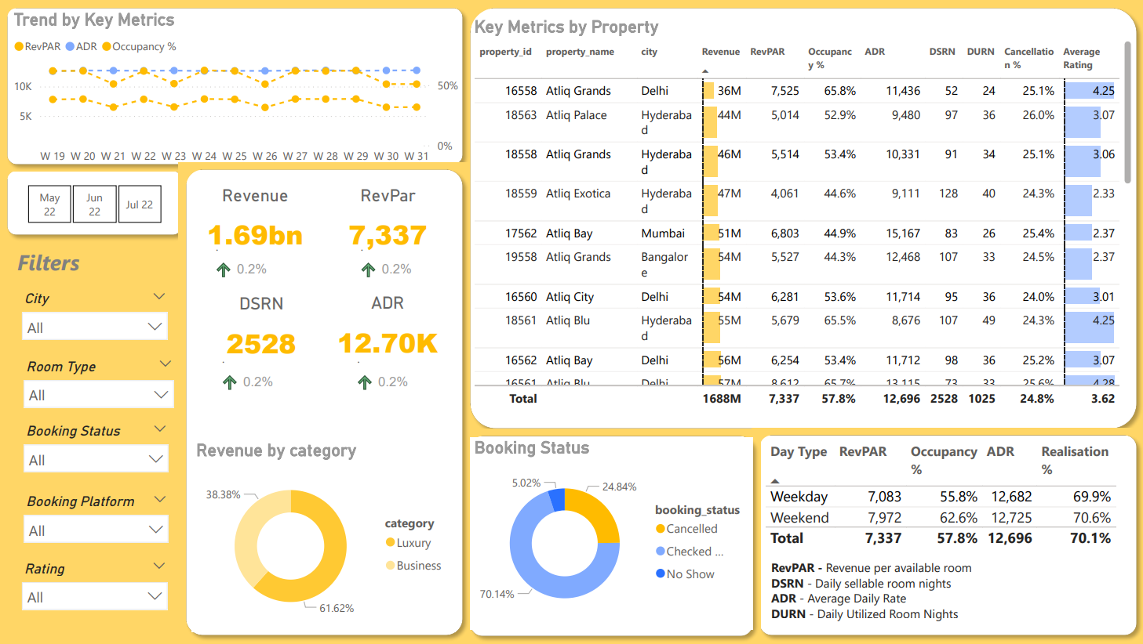
Dashboarding

Slide 12
Revenue Performance
Mumbai
Bangalore
Generated Highest Revenue
Generated Good Revenue
660.6M
415.0M
Hyderabad
Delhi
Generated Moderate Revenue
Generated Lowest Revenue
321.3M
290.9M

Slide 13
Key Insights
Revenue Performance:
Mumbai generated the highest revenue at $669M
Delhi generated the lowest revenue at $290.92M.
Total revenue stood at $1.69 billion, with the luxury segment contributing 61.62% and the business category contributing 38.82%
Occupancy Rates:
Delhi had the highest occupancy rate at 60.44%, despite having the lowest Daily Sales Rate per Night (DSRN) of $435.
Bangalore recorded the lowest occupancy rate at 55.68%
Occupancy Rates:
Delhi had the highest occupancy rate at 60.44%, despite having the lowest Daily Sales Rate per Night (DSRN) of $435.Bangalore recorded the lowest occupancy rate at 55.68%
Weekend Insights:
Occupancy rates on weekends (Friday-Saturday) were 7% higher than on weekdays, though the difference in Revenue Per Available Room (RevPAR) was negligible.

Slide 14
Key Insights
Monthly Revenue:
The highest revenue was generated in May, amounting to $581.93M, surpassing the figures for June and July.
Room Class Revenue:
The Elite room class generated the highest revenue at $553.74M.The Standard room class generated the lowest revenue at 3305.74M
Booking Sources
The majority of bookings were from other sources (19K), followed by MakeMyTrip (9K).
Overall Metrics
Total revenue: $1.69 billion
Average occupancy rate: 57.79%
Cancellation rate: 24.84%
Average rating: 3.62
RevPAR (Revenue Per Available Room):
Highest Rev PAR Mumbai at $8.9
KLowest RevPAR: Hyderabad at $5.4K

Slide 15
Recommendation
AtliQ Grands can enhance revenue generation by harnessing dynamic pricing strategies, particularly by adjusting prices upwards during peak days and weekends when demand is high.
To increase bookings and revenue on offline booking platforms, AtliQ Grands should explore differential pricing strategies. This involves launching targeted marketing campaigns and promotions to attract customers, potentially from a different segment.
To further improve customer satisfaction, AtliQ Grands should give increased attention to customer reviews and ratings. Addressing critical areas identified in these reviews showcases a commitment to enhancing the overall customer experience.
Reducing reliance on third-party online platforms can be achieved by exploring opportunities to increase direct bookings through the hotel's website. AtliQ Grands may consider offering incentives, exclusive promotions, or benefits to encourage customers to book directly, thereby saving on commission fees.

Slide 16
CONCLUSION
The application of Power BI for data analysis has yielded valuable insights across various facets of managing AtliQ Grands Hotel. The discoveries and suggestions derived can optimize operational efficiency, elevate customer satisfaction, and foster revenue growth. Consistent monitoring and analysis of key metrics will ensure the sustained success of the hotel

Slide 17
ThAnK YoU

